Slide 1

Sallys Tacos Restaurant
Project 1
By Jorge Quintero

Slide 2
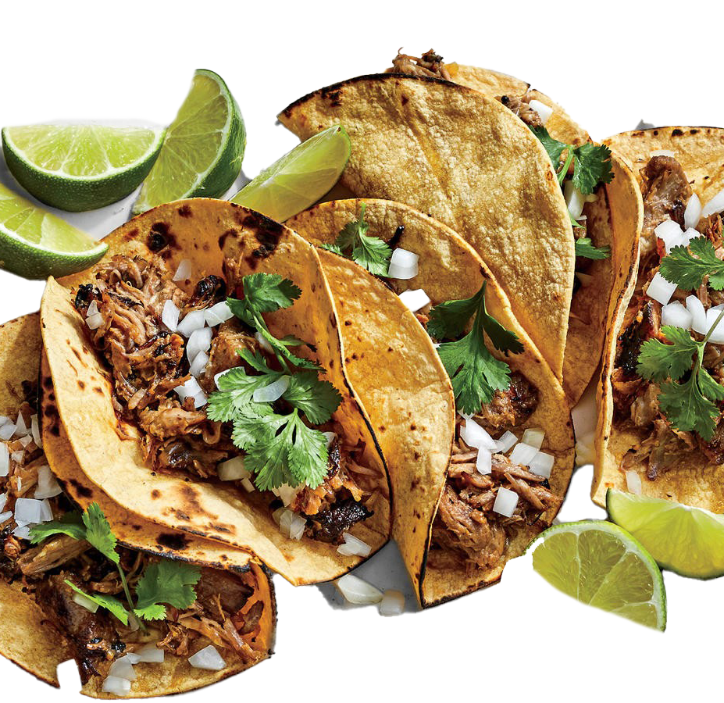
Welcome To Sallys Tacos
Where you can experience authentic food with fantastic flavor and Great prices.

Slide 3
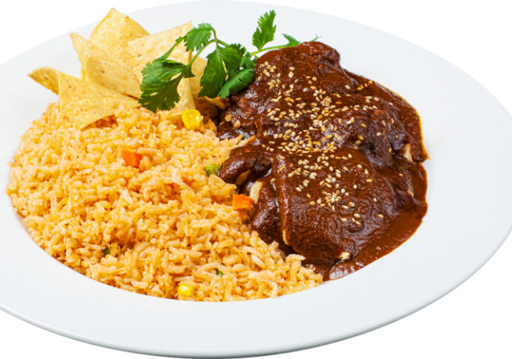
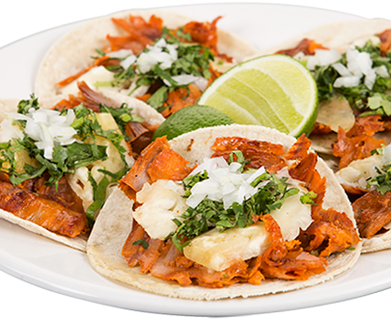
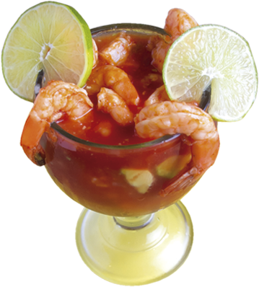
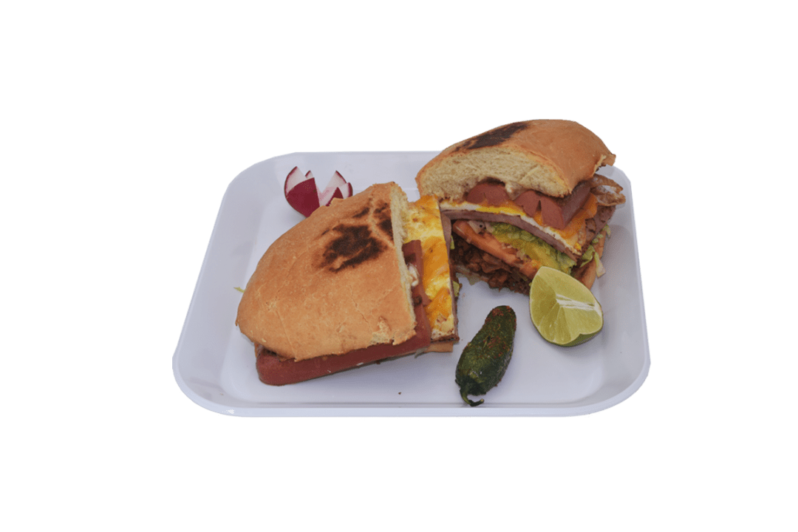
What To Expect
All authentic Mexican food

Slide 4
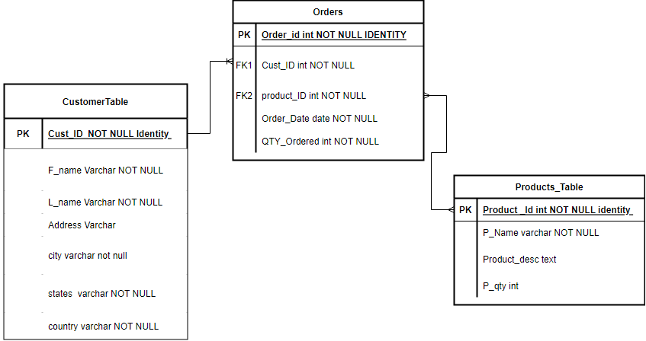
ER Diagram

Slide 5
Technology used
Software used
Visual Studio
.NET 5.0
MSSMS
Languages
SQL
C#

Slide 6
Future improvements
Pictures
Easier UI for Customers / employees
Drop down menu
Order more than one type of item per order
An easier to read menu

Slide 7
Conclusion
Great food at a great price, and all authentic!
Now let's see the Web API in action!

